Slide 1

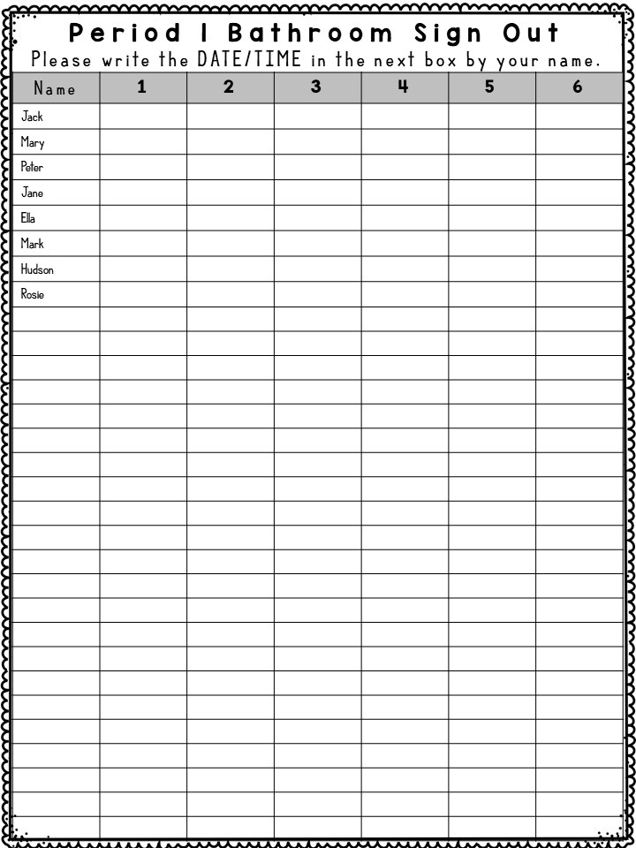
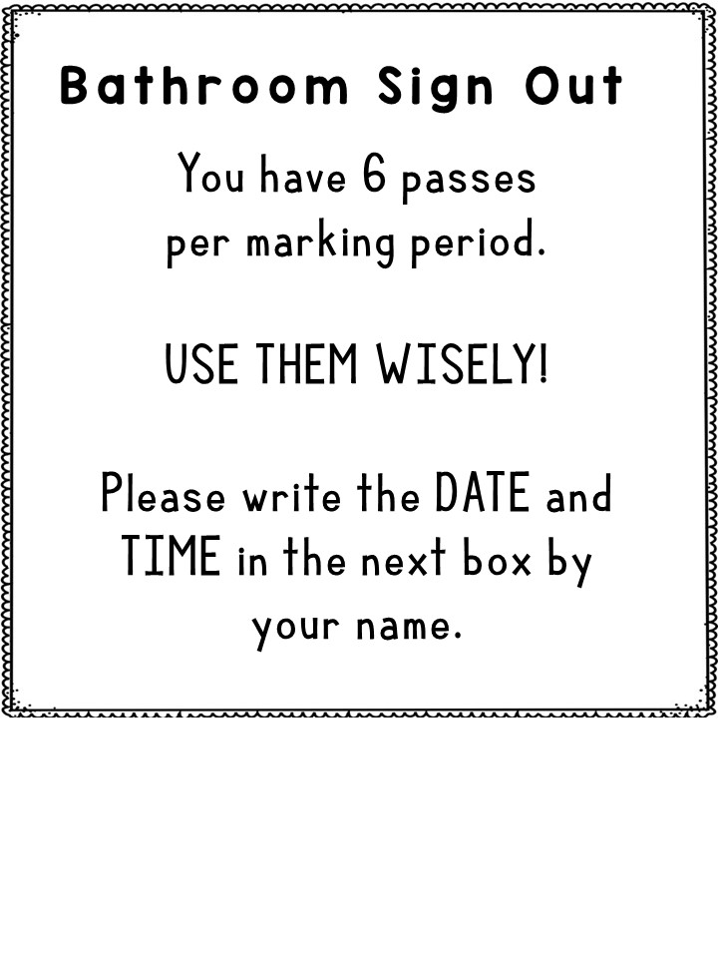




This is an EDITABLE bathroom sign out sheet using my 6-passes per marking quarter strategy. Read my blog post here!
If you’d like to keep the same fonts, simply download and install the following two fonts onto your computer. These are FREE to use in educational resources in the classroom. The headings are Red Hands and the smaller font is Compassion BIG.
  Red Hands by Kimberly Geswein
  Compassion BIG by Kimberly Geswein
Edit the Period # (if applicable), the number of rows on the table, and the student names. Duplicate page 3 for however many classes you have. Print out all lists and mount them near your door.
Once students have left 6 times in a marking quarter they are all out of passes and I put a highlight through their name/line. Surprisingly, this rarely happens!
I hope this resource is helpful for you!
www.SunriseScience.blog

Slide 2

Bathroom Sign Out
You have 6 passes
per marking period.
USE THEM WISELY!
Please write the DATE and TIME in the next box by your name.

Slide 3
Period 1 Bathroom Sign Out
Please write the DATE/TIME in the next box by your name.
Name | 1 | 2 | 3 | 4 | 5 | 6
Jack
Mary
Peter
Jane
Ella
Mark
Hudson
Rosie

